Slide 1
Structural variation of 30,659 bipolar and schizophrenia patients identifies novel genetic insights
Robert Ye
On behalf of the Whole Genome Sequencing for Psychiatric Disorders Consortium (WGSPD)
Neale and Talkowski Labs

Slide 2
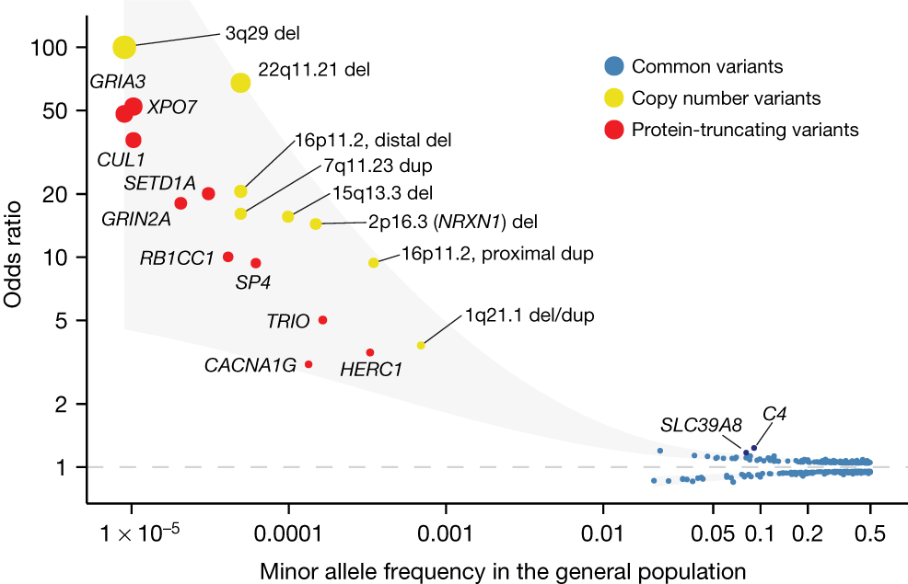
Rare coding variation is enriched in schizophrenia cases
Singh et al. (2022) Nature

Slide 3
Rare coding variation is enriched in schizophrenia cases
What more can we learn from whole genome sequencing?
Singh et al. (2022) Nature

Slide 4
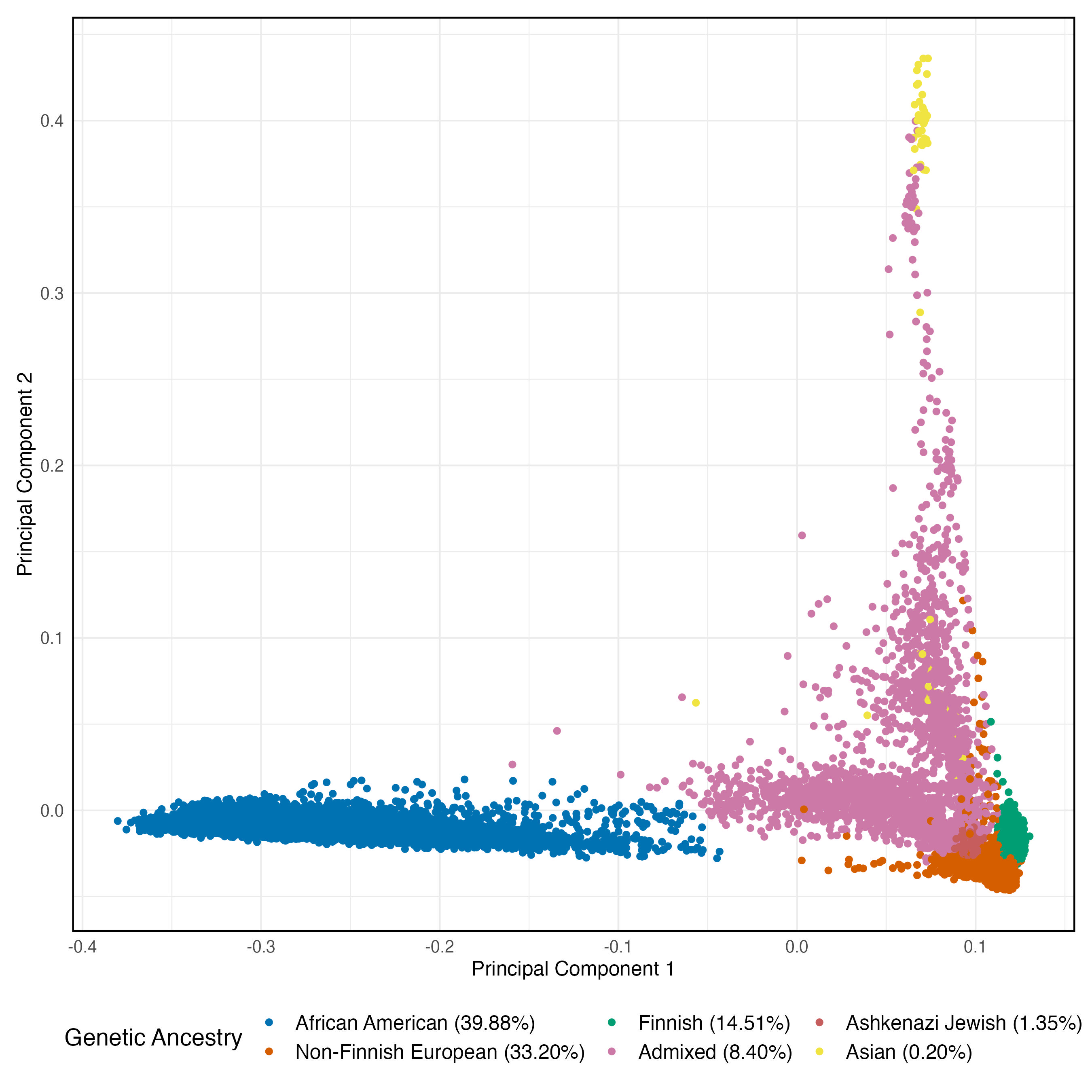
WGSPD
Schizophrenia (7,224)
Bipolar Disorder (2,358)
Controls (23,664)

Slide 5
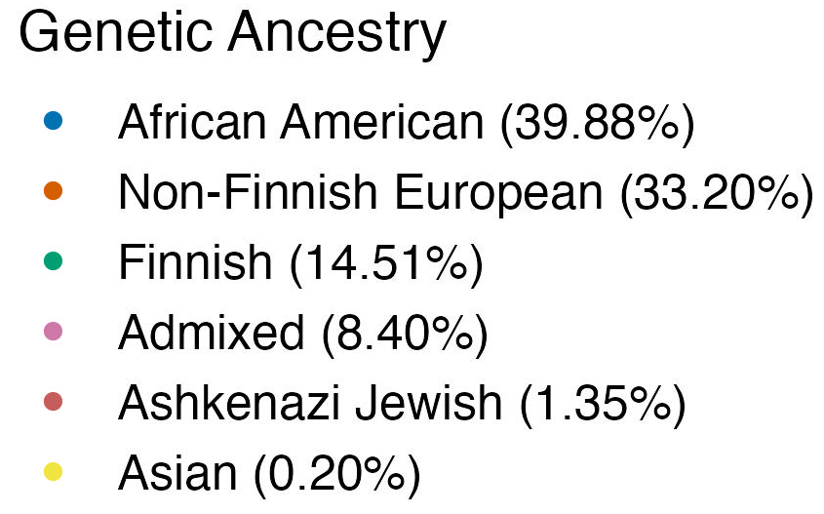

Slide 6
Gene sets in our analyses
Gene set | # genes | Source
Schizophrenia | 32 | Singh et al. (2022) Nature
Autism Spectrum Disorder | 72 | Fu et al. (2022) Nat Genet
Neurodevelopmental Disorder | 373 | Fu et al. (2022) Nat Genet
Constrained Genes | 3570 | Karczewski et al. (2020) Nature

Slide 7
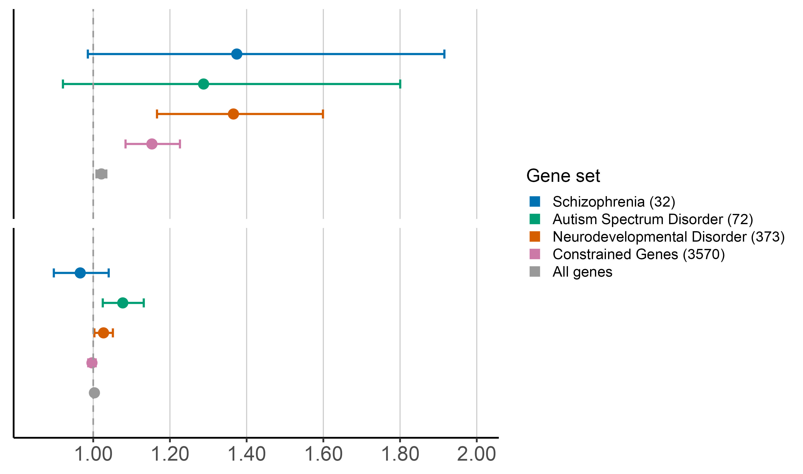
Coding SNVs
Protein
Truncating
Variants
(PTVs)
There is an expected enrichment of rare protein truncating variants (PTVs) in constrained and neuropsychiatric genes
Odds ratio (95% CI)

Slide 8
Coding SNVs
Protein
Truncating
Variants
(PTVs)
There is an expected lack of enrichment of rare synonymous variation in constrained and neuropsychiatric genes
Odds ratio (95% CI)
Synonymous
Variants
Odds ratio (95% CI)

Slide 9
Coding SNVs
Protein
Truncating
Variants
(PTVs)
There is an expected lack of enrichment of rare synonymous variants in constrained and neuropsychiatric genes
What about noncoding regions?
Odds ratio (95% CI)
Synonymous
Variants
Odds ratio (95% CI)

Slide 10
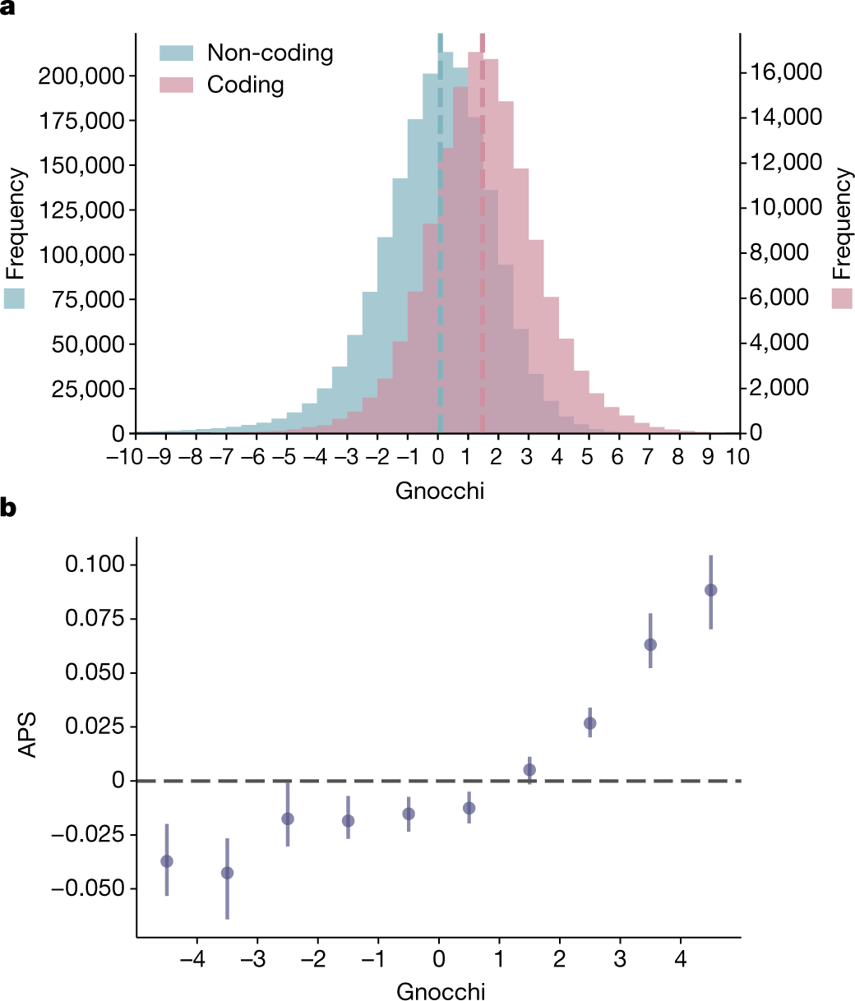
Noncoding constraint focuses the scope of our analysis
Chen et al. (2024)

Slide 11
Noncoding constraint focuses the scope of our analysis
Chen et al. (2024)

Slide 12
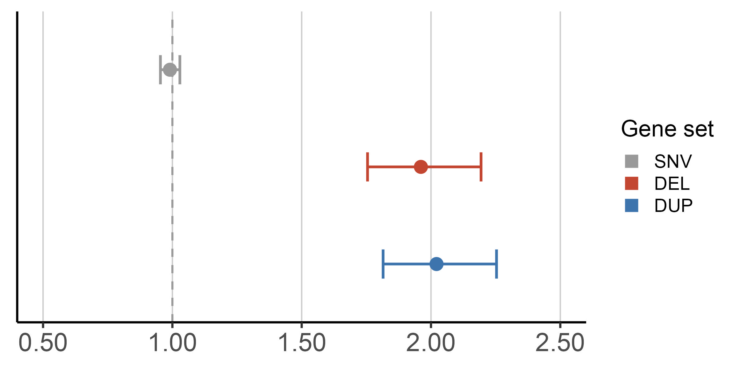
Noncoding Constrained Regions
Noncoding
SNV
There is no significant enrichment of rare single nucleotide variation (SNV) in noncoding constrained regions…
Odds ratio (95% CI)

Slide 13
Noncoding Constrained Regions
However, there is a significant enrichment of rare deletion and duplication structural variation (SV) in noncoding constrained regions
Noncoding
SNV
Deletion
SV
Duplication
SV
Odds ratio (95% CI)

Slide 14
Noncoding Constrained Regions
However, there is a significant enrichment of rare deletion and duplication structural variation (SV) in noncoding constrained regions
Noncoding
SNV
Let’s focus on structural variation instead
Deletion
SV
Duplication
SV
Odds ratio (95% CI)

Slide 15
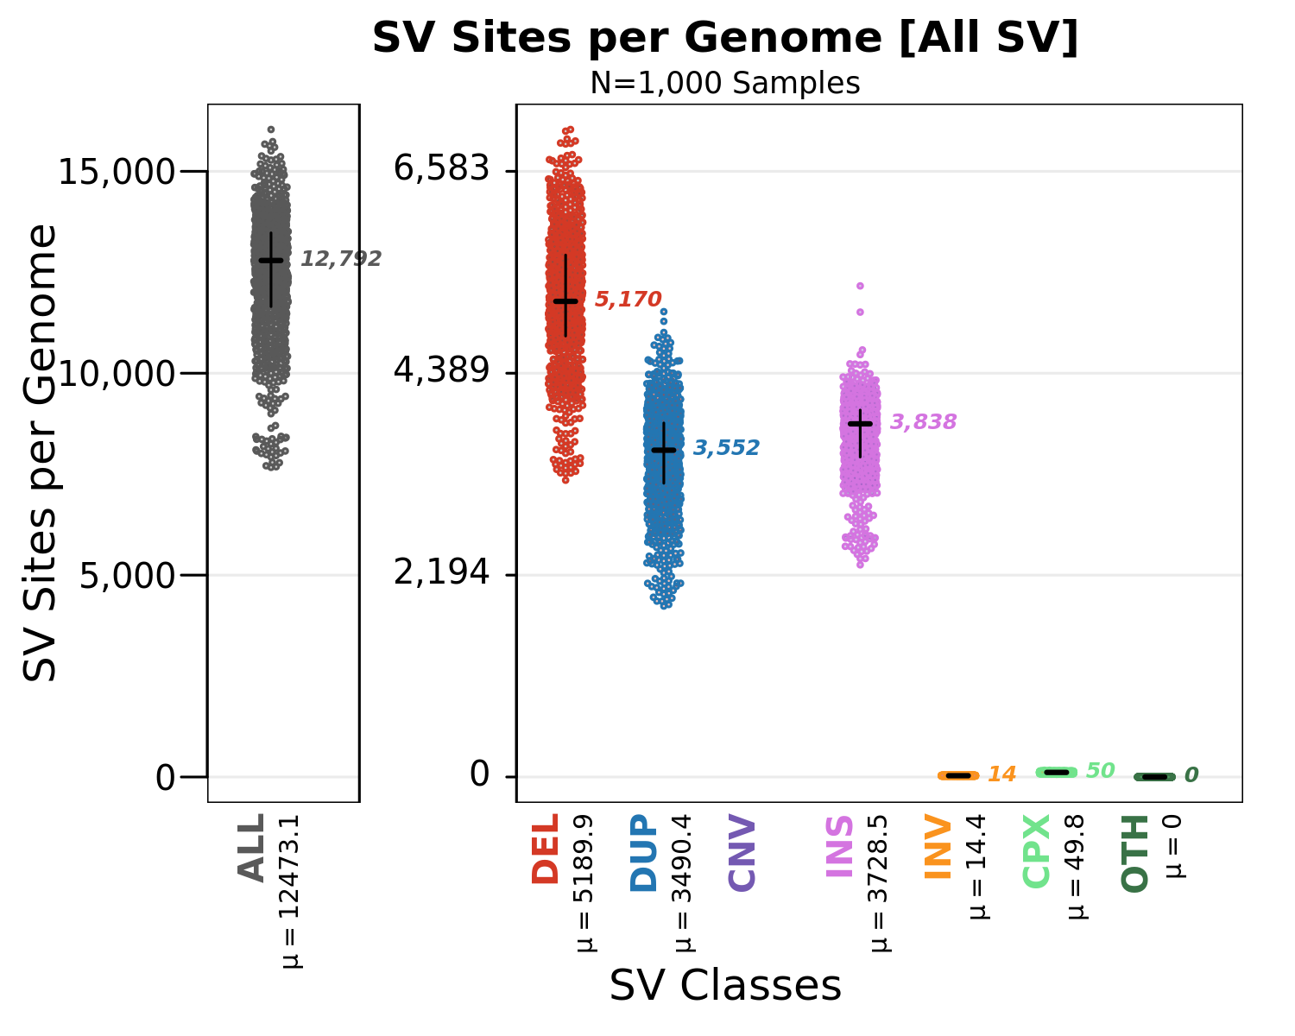
Deletion events are well-characterized in WGSPD

Slide 16
Deletion events are well-characterized in WGSPD

Slide 17
Deletion events are well-characterized in WGSPD

Slide 18
Our deletion class of interest
Promoter
Exon 1
Intron
Exon 2
Intron
Exon 3
Intron
Exon 4
5’ UTR
CDS

Slide 19
Our deletion class of interest
Exonic
Deletion
Promoter
Exon 1
Intron
Exon 2
Intron
Exon 3
Intron
Exon 4
5’ UTR
CDS

Slide 20
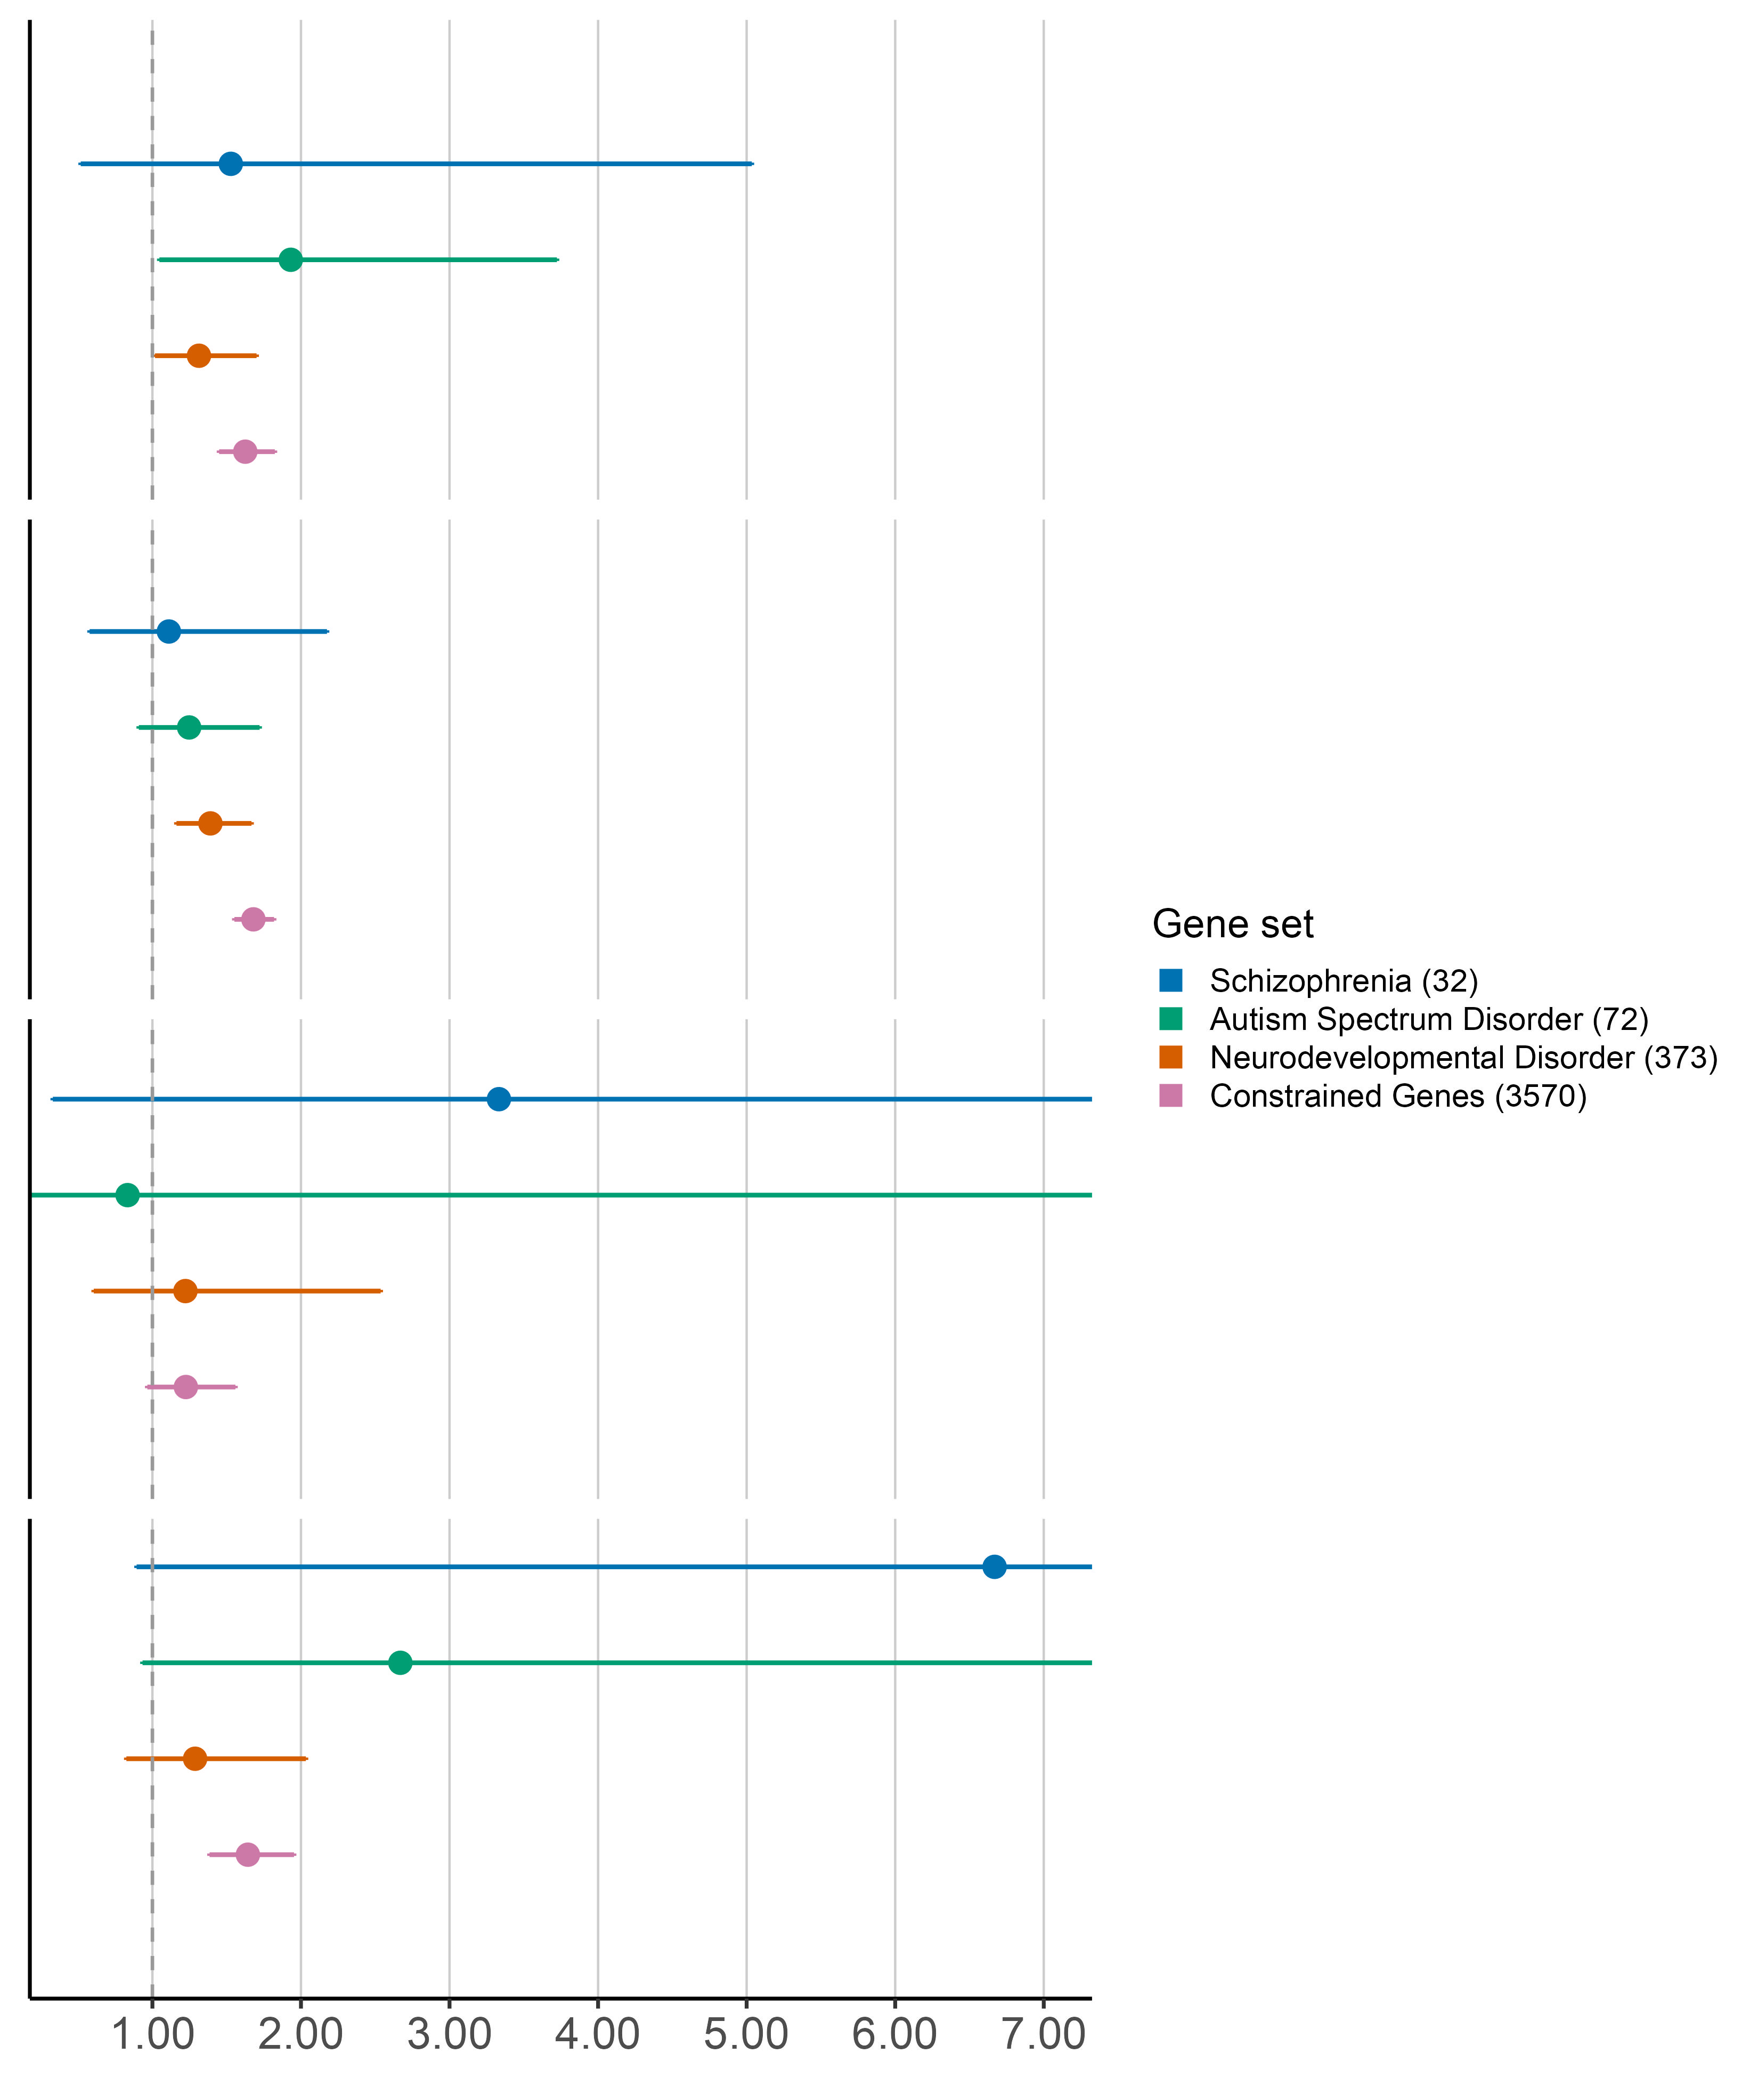
Promoter
Exon 1
Intron
Exon 2
Intron
Exon 3
Intron
Exon 4
5’ UTR
CDS
Deletion SVs recapitulate exonic SNV enrichment and detect additional intronic enrichment
Deletion SVs
Exonic deletion SVs recapitulate coding SNV enrichment
Exonic
Odds ratio (95% CI)

Slide 21
Our deletion class of interest
Intronic
Deletion
Promoter
Exon 1
Intron
Exon 2
Intron
Exon 3
Intron
Exon 4
5’ UTR
CDS

Slide 22
Promoter
Exon 1
Intron
Exon 2
Intron
Exon 3
Intron
Exon 4
5’ UTR
CDS
Deletion SVs recapitulate exonic SNV enrichment and detect additional intronic enrichment
Deletion SVs
Intronic deletion SVs detect additional intronic enrichment
Intronic
Odds ratio (95% CI)

Slide 23
Our deletion class of interest
Promoter
Deletion
Promoter
Exon 1
Intron
Exon 2
Intron
Exon 3
Intron
Exon 4
5’ UTR
CDS

Slide 24
Promoter
Exon 1
Intron
Exon 2
Intron
Exon 3
Intron
Exon 4
Deletion SVs affecting promoter and 5’ UTR regions show a strong positive enrichment in constrained genes and schizophrenia-associated genes
5’ UTR
CDS
Deletion SVs affecting promoter regions suggest a positive enrichment in constrained and schizophrenia-associated genes
Deletion SVs
Promoter
Odds ratio (95% CI)

Slide 25
Promoter
Exon 1
Intron
Exon 2
Intron
Exon 3
Intron
Exon 4
Deletion SVs affecting promoter and 5’ UTR regions show a strong positive enrichment in constrained genes and schizophrenia-associated genes
5’ UTR
CDS
Deletion SVs affecting promoter regions suggest a positive enrichment in constrained and schizophrenia-associated genes
Deletion SVs
Promoter
Odds ratio (95% CI)

Slide 26
Our deletion class of interest
5’ UTR
Deletion
Promoter
Exon 1
Intron
Exon 2
Intron
Exon 3
Intron
Exon 4
5’ UTR
CDS

Slide 27
Promoter
Exon 1
Intron
Exon 2
Intron
Exon 3
Intron
Exon 4
Deletion SVs affecting promoter and 5’ UTR regions show a strong positive enrichment in constrained genes and schizophrenia-associated genes
5’ UTR
CDS
Deletion SVs affecting
5’ UTR regions suggest a positive enrichment in constrained and schizophrenia-associated genes
Deletion SVs
5’ UTR
Odds ratio (95% CI)

Slide 28
Deletion SVs
Deletion SVs affecting promoter and 5’ UTR regions show a strong positive enrichment in constrained genes and schizophrenia-associated genes
Promoter
Deletion SVs affecting promoter and 5’ UTR regions show a strong positive enrichment in constrained and schizophrenia-associated genes
5’ UTR
Odds ratio (95% CI)

Slide 29
Deletion SVs
Deletion SVs affecting promoter and 5’ UTR regions show a strong positive enrichment in constrained genes and schizophrenia-associated genes
Promoter
Deletion SVs affecting promoter and 5’ UTR regions show a strong positive enrichment in constrained and schizophrenia-associated genes
Incorporating SVs may help improve gene discovery
5’ UTR
Odds ratio (95% CI)

Slide 30
Genes affected by 5’ UTR deletions are among previously identified, significant schizophrenia-associated genes
SRRM2 ANKRD12
KDM6B EIF2S3
MAGI2

Slide 31
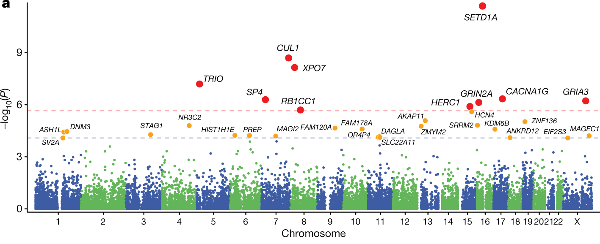
Genes affected by 5’ UTR deletions are among previously identified, significant schizophrenia-associated genes
SRRM2 ANKRD12
KDM6B EIF2S3
MAGI2

Slide 32
Noncoding Constrained Regions
Noncoding
SNV
There is no significant enrichment of SNVs, but significant enrichment of SVs in noncoding constrained regions
Deletion
SV
Duplication
SV
Odds ratio (95% CI)

Slide 33
Conclusions
Noncoding SNVs are not as biologically interpretable
SVs can help identify noncoding constrained regions associated with neuropsychiatric disorders
SVs affecting noncoding regions, such as the promoter and UTR, may contribute towards disease risk
Incorporating SVs may help improve gene discovery

Slide 34

Acknowledgements
Talkowski Lab:
Mike Talkowski
Cal Liao
Jack Fu
Chelsea Lowther
Xuefang Zhao
Neale Lab:
Benjamin Neale
Cal Liao
Patrick Schultz
Siwei Chen
Dan Howrigan
Sinéad Chapman
Caroline Cusick
Sam Bryant
WGSPD consortium collaborators:
Michael Boehnke – University of Michigan
Nelson Freimer – University of California, Los Angeles
Stacey Gabriel – Broad Institute of MIT and Harvard
Sarah Gagliano – University of Michigan
Guilio Genovese – Broad Institute of MIT and Harvard
David Glahn – Boston Children’s Hospital
James Knowles – SUNY Downstate Medical Center
Steven McCarroll – Harvard University
Hyun Min Kang – University of Michigan
Roel Ophoff – University of California, Los Angeles
Aarno Palotie – University of Helsinki
Duncan Palmer – Broad Institute of MIT and Harvard
Carlos Pato – SUNY Downstate Medical Center
Michele Pato – SUNY Downstate Medical Center
Laura Scott – University of Michigan
Sponsors:
Stanley Foundation
BD2
Dalio Foundation
Dauten Family
NIMH

Slide 36
Gnocchi is well calibrated to assess SV constraint
Chen et al. (2024)

Slide 37
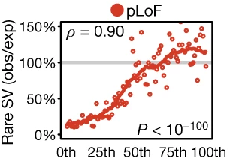
There is a strong concordance between rare deletion SVs and existing SNV constraint metrics.
pLoF SNV constraint (LOEUF) percentile
Collins et al. (2020) Nature

Slide 38
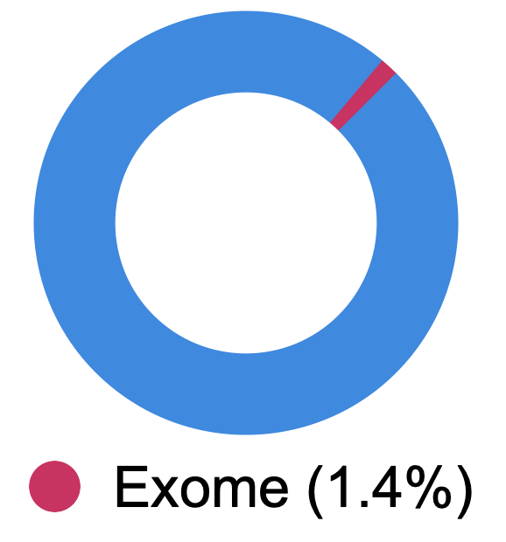
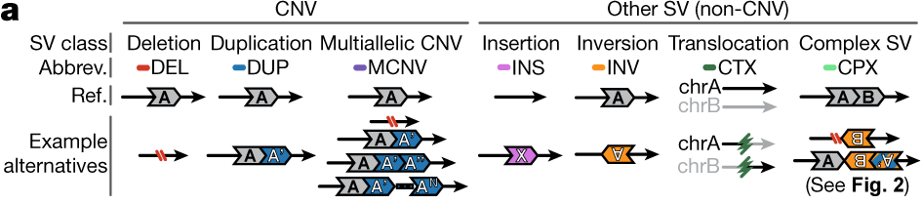
Advantages of SV calling in WGS
Human genome
Genome-wide coverage
Ability to capture full range of SV types
10,000x more SVs detected per genome
Collins, R.L., Brand, H., Karczewski, K.J. et al. (2020) Nature
Slide courtesy of Emma Pierce-Hoffman

Slide 39


SV discovery with GATK-SV
SV callers
Joint genotyping
Manta
MELT
Wham
cn.MOPS
Clustering
GATK-gCNV
Complex event resolution
Evidence types
Paired end
Split read
Filtering
Read depth
B-Allele frequency
Collins et al., Nature (2020)
Functional annotation

Slide 40
Characterization of SV sizes in WGSPD

Slide 41
Characterization of SV counts in gnomAD v4
Count of SVs per Genome
by population

